Slide 1


PlantScan AI
Instantly detect and diagnose plant diseases with high accuracy.

Slide 2


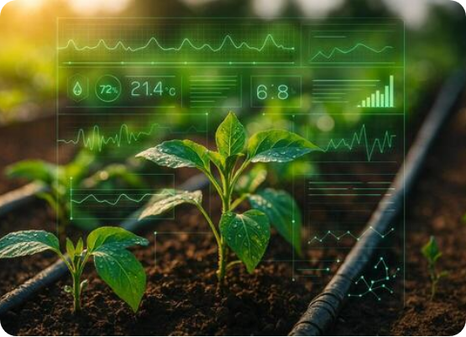
Empowering Agriculture with AI
•
The Challenge: Rapid and accurate identification of crop diseases is difficult but critical for yield preservation and sustainable farming.
•
The Solution: PlantScan AI is an advanced dashboard providing real-time disease analysis across 38 distinct plant and disease classes.
•
Beyond Detection: Integrates generative AI to provide immediate, actionable treatment and proactive prevention plans.

Slide 3







Modern Microservice Architecture
Frontend Presentation
Backend Gateway
Inference Engines
Built on React (Vite) with a state-of-the-art glassmorphism interface. Utilizes dynamic fluid overlays and GPU frame buffers for immersive user interaction.
High-throughput FastAPI microservice resolving concurrent processing streams. Features dynamic transforms matching static pre-training normalization stats.
Dual loading environments supporting both TensorFlow (Keras) and PyTorch weights seamlessly, ensuring hot-swappable AI inference without latency.

Slide 4






Selectable High-Precision Networks
TensorFlow (Keras)
PyTorch (Base)
PyTorch (SOTA)
Architecture: Custom CNN Backbone optimized for standard CPU/GPU metrics.
Architecture: EfficientNetV2-S with rigid static frame pre-training weights.
Architecture: EfficientNetV2-S Fully Un-fused Fine-Tuned network.
Benchmark: ~89.00% Validation Accuracy
Benchmark: 89.54% Static Frame Accuracy
Benchmark: 99.63% Peak Inference Accuracy

Slide 5


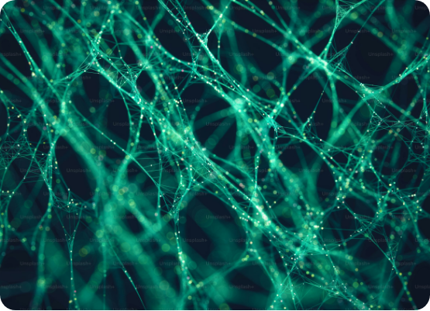
Achieving 99.6% Accuracy
•
Dataset & Scope: Trained on a massive dataset across 38 diverse plant and disease categories.
•
Advanced Augmentation: Utilizes horizontal/vertical flips, aggressive rotation, and color jitter to simulate real-world, outdoor lighting and shadows.
•
Full Fine-Tuning: Unfrozen EfficientNetV2-S base weights with a custom, high-dropout classification head for profound pattern recognition.
•
Hardware Acceleration: Trained using Automatic Mixed Precision (AMP) for optimized gradient scaling and memory efficiency.

Slide 6




Actionable Generative AI Guidance
Local LLM Integration
Structured Output
Powered by the highly capable google/gemma-3-4b model via a dedicated local endpoint. The system is context-aware and automatically triggers a deep analysis when a non-healthy plant is diagnosed, ensuring immediate and relevant guidance.
Strictly enforced prompt engineering guarantees precision formatting. The AI reliably outputs exactly two concise prevention tactics and two cure tactics without conversational filler, making it instantly actionable for the end user.

Slide 7


Bridging Vision and Intelligence
From raw agricultural data to a sub-1% error rate computer vision pipeline.

